Slide 1

Priority Queue and Heaps
Data Structures
Dr. Bouchaib Falah

Slide 2
Complete Binary Tree
A binary tree is a complete if:
Intermediate Nodes between levels 0 and h-3 have 2 children
Nodes at level h – 2 have 0, 1 or 2 children. If there is one child then it is the left one:
Left-Adjusted
Examples:

Slide 3
Array-Based Representation of a Binary Tree
root
0
Pam
free
10
Joe
Sue
Bob
Mike
Sam
Tom
Ann
Jane
Mary

Slide 4
Left Child & Right Child in a Complete, Array-Based Binary Tree
Suppose that the nodes of a binary tree are stored in an array as follows:
First, store the root, which is at level 0.
Next, store the nodes at level 1;
Then, store the nodes at level 2;
. . .
Suppose also that at every level, the nodes are stored from left to right.
If the binary tree is complete, then for any node at array position i, its left child will be at position 2*i + 1, and its right child will be at position 2*i + 2.

Slide 5
Left Child & Right Child in a Complete, Array-Based Binary Tree
Pam
Joe
Sue
Bob
Mike
Sam
Tom
Ann
Jane
Mary
LeftChild(i) = 2*i + 1
RightChild(i) = 2*i + 2

Slide 6
Parent in a Complete, Array-Based Binary Tree
If the array-based binary tree is complete, then for any node at array position i, its parent will be at position
⎣ (i – 1) / 2 ⎦
Examples:
i = 4: ⎣ (i – 1) / 2 ⎦ = ⎣ 3 / 2 ⎦ = 1
i = 3: ⎣ (i – 1) / 2 ⎦ = ⎣ 2 / 2 ⎦ = 1
i = 2: ⎣ (i – 1) / 2 ⎦ = ⎣ 1 / 2 ⎦ = 0
i = 1: ⎣ (i – 1) / 2 ⎦ = ⎣ 0 / 2 ⎦ = 0
i = 0: ⎣ (i – 1) / 2 ⎦ = ⎣ -1/ 2 ⎦ = -1

Slide 7
Parent in a Complete, Array-Based Binary Tree
Pam
Joe
Sue
Bob
Mike
Sam
Tom
Ann
Jane
Mary
Parent(i) = ⎣ (i – 1) / 2 ⎦

Slide 8
Heaps
A heap is a complete binary tree that is either:
empty, or
consists of a root and two subtrees, such that
both subtrees are heaps, and
the root contains a search key that is ≥ the search key of each of its children.
NB: The children are not ordered (Not like in BST)
Nodes can have the same priority

Slide 9
Array-Based Representation of a Heap
10
Tom
7
9
Pam
Sue
5
6
8
1
Mary
Mike
Sam
Ann
4
2
3
Joe
Bob
Jane

Slide 10

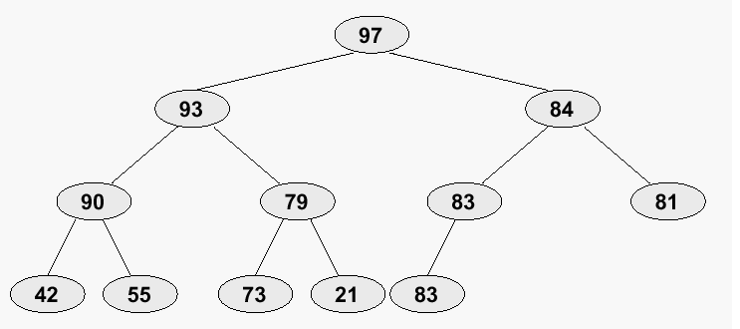
Heaps - Example

Slide 11
Array-Based Representation of a Heap
Note that, for any node, the search key of its left child is not necessarily ≤ or ≥ the search key of its right child.
The only constraint is that any parent node must have a search key that is ≥ the search key of both of its children.
Note that this is sufficient to ensure that the item with the greatest search key in the heap is stored at the root.
In the array-based representation we have discussed, the item with the greatest search key will always be at position 0 of the array.

Slide 12
The Priority Queue ADT
A priority queue is an ADT in which items are ordered by a priority value. The item with the highest priority is always the next to be removed from the queue. (Highest Priority In, First Out: HPIFO)
Examples:
Printers
Operating System Scheduler
Operations:
Main Operation:
Insert / Enqueue
DeleteMax / Dequeue
Other Operations:
getMin/Max
DeleteMin
IsEmpty
Size

Slide 13
Heaps - Implementation
The Illustrated ‘Tree’ is in fact a logical Presentation
Because Heaps are Left-Adjusted Complete Binary trees, they are easily implemented using an Array
The number of nodes N in any Heap of height h is: 2^{h} ≤ N ≤2^{h+1} - 1
Implementation: How? For every element at index K:
left child is at index 2K+1
Right child is at index 2K+2
parent is at index ⎣(K-1)/2⎦

Slide 14
Building a Heap from an Array Algorithm
A = Array - with Random Order
For (int i = (arrayLength/2)-1; i>0;i--)
Heapify(A, i);
Heapify(A, i) {
If it is not a leaf
Get largest: the index of the largest element among (A[i], leftChild, rightChild)
If (largest ≠ i)
Swap(&A[i], &A[largest])
Heapify(A, Largest)
}

Slide 15
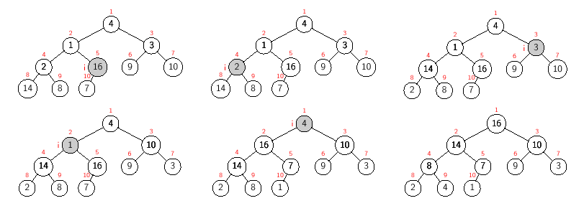
Building a Heap from an Array Example

Slide 16
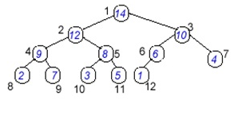
Heaps – Insert
point to the FIRST empty location IN THE LAST LEVEL
Insert the new element
If the new element has bigger priority than the parent then swap it up till having a parent with greater priority OR till placed in the Root

Slide 17
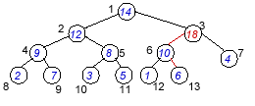
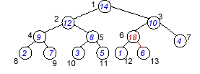
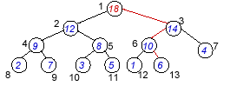
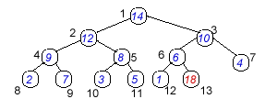
Insert - Illustration

Slide 18
Heaps - Delete
Get the one at the root
The element with highest Priority is always at the Root
(heapSize--)
Replace it with the last one
Adjust the heap:
child = 2*root+1;
While (child <= heapSize-1) {
If(A[child] < A[child+1])
child++; // get the max Child
If (A[child] > A[root])
Swap(A[child], A[root]);
Root = child;
child = 2*root + 1
Else
Break;
}  O(Log N)

Slide 19
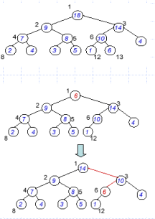
Heaps - Delete

Slide 20
Exercise
Implement a heap by inserting the following nodes in this order: 11, 5, 13, 3, 7, 6, 77, 1, 4, 222
Print the heap after each insertion.
Dequeue each node and print each deleted node.
Your final output should be similar to the screen shot in the next slide

Slide 21
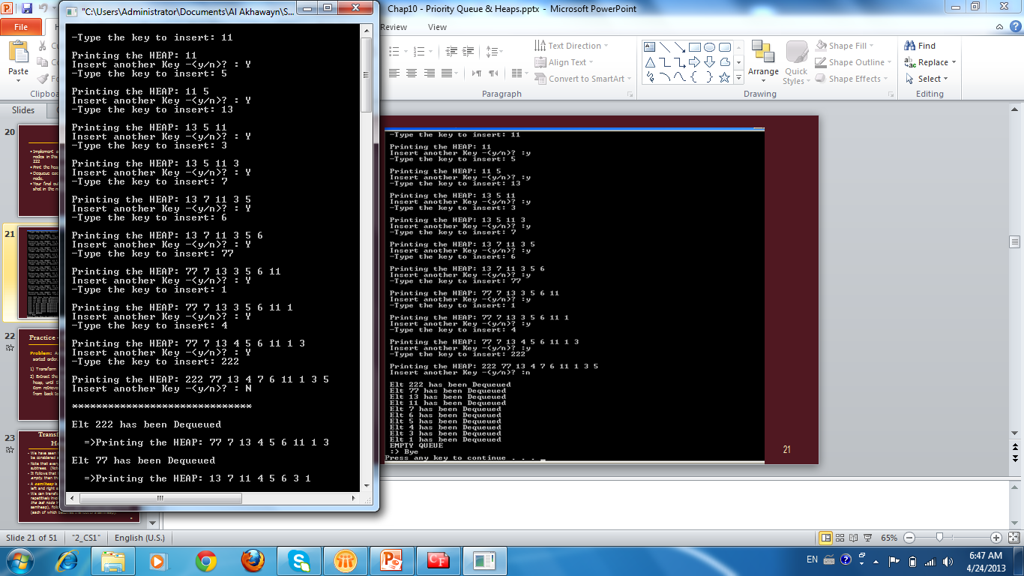

Slide 22
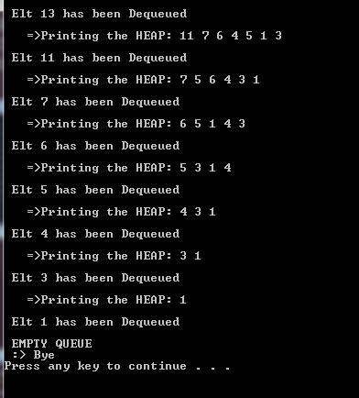

Slide 23
Practice – Heapsort: Basic Idea
Problem: Arrange an array of items into sorted order.
1) Transform the array of items into a heap.
2) Extract the largest item remaining in the heap, until the heap is empty. Store each item retrieved from the heap into the array from back to front.

Slide 24
Transform an Array Into a Heap: Basic Idea
We have seen how the consecutive items in an array can be considered as the nodes of a complete binary tree.
Note that every leaf is a heap, since a leaf has two empty subtrees. (Note that the last node in the array is a leaf.)
It follows that if each child of a node is either a leaf or empty, then that node is the root of a semiheap.
A semiheap is a complete binary tree in which the root’s left and right subtrees are both heaps.
We can transform an array of items into a heap by repetitively invoking rebuildHeap, first on the parent of the last node in the array (which is the root of a semiheap), followed by each preceding node in the array (each of which becomes the root of a semiheap).

Slide 25
Transform an Array Into a Heap: Example
6
3
5
7
2
4
10
9
0
1
2
3
4
5
6
7
rebuildHeap
The items in the array, above, can be considered to be stored in a complete binary tree.
Note that leaves 2, 4, 9 & 10 are heaps; nodes 5 & 7 are roots of semiheaps.
rebuildHeap is invoked on the parent of the last node in the array (= 9).
6
3
5
7
2
4
10
9

Slide 26
Transform an Array Into a Heap: Example
6
3
5
9
2
4
10
7
0
1
2
3
4
5
6
7
rebuildHeap
Note that nodes 2, 4, 7, 9 & 10 are roots of heaps; nodes 3 & 5 are roots of semiheaps.
rebuildHeap is invoked on the node in the array preceding node 9.
6
3
5
9
2
4
10
7

Slide 27
Transform an Array Into a Heap: Example
6
3
10
9
2
4
5
7
0
1
2
3
4
5
6
7
rebuildHeap
Note that nodes 2, 4, 5, 7, 9 & 10 are roots of heaps; node 3 is the root of a semiheap.
rebuildHeap is invoked on the node in the array preceding node 10.
6
3
10
9
2
4
5
7

Slide 28
Transform an Array Into a Heap: Example
6
9
10
3
2
4
5
7
0
1
2
3
4
5
6
7
rebuildHeap
Note that nodes 2, 4, 5, 7 & 10 are roots of heaps; node 3 is the root of a semiheap.
rebuildHeap is invoked recursively on node 3 to complete the transformation of the semiheap rooted at 9 into a heap.
6
9
10
3
2
4
5
7

Slide 29
Transform an Array Into a Heap: Example
6
9
10
7
2
4
5
3
0
1
2
3
4
5
6
7
rebuildHeap
Note that nodes 2, 3, 4, 5, 7, 9 & 10 are roots of heaps; node 6 is the root of a semiheap.
The recursive call to rebuildHeap returns to node 9.
rebuildHeap is invoked on the node in the array preceding node 9.
6
9
10
7
2
4
5
3

Slide 30
Transform an Array Into a Heap: Example
10
9
6
7
2
4
5
3
0
1
2
3
4
5
6
7
10
Note that node 10 is now the root of a heap.
The transformation of the array into a heap is complete.
9
6
7
2
4
5
3

Slide 31
Transform a Heap Into a Sorted Array
After transforming the array of items into a heap, the next step in Heapsort is to:
extract the largest item remaining in the heap, until the heap is empty. Store each item retrieved from the heap into the array from back to front.
If we want to perform the preceding step without using additional memory, we need to be careful about how we delete an item from the heap and how we store it back into the array.

Slide 32
Transform a Heap Into a Sorted Array: Basic Idea
Problem: Transform array a[ ] from a heap of n items into a sequence of n items in sorted order.
Let last represent the position of the last node in the heap. Initially, the heap is in a[ 0 .. last ], where last = n – 1.
1) Move the largest item in the heap to the beginning of an (initially empty) sorted region of a[ ] by swapping a[0] with a[ last ].
2) Decrement last. a[0] now represents the root of a semiheap in a[ 0 .. last ], and the sorted region is in
a[ last + 1 .. n – 1 ].
3) Invoke rebuildHeap on the semiheap rooted at a[0] to transform the semiheap into a heap.
4) Repeat steps 1 - 3 until last = -1. When done, the items in array a[ ] will be arranged in sorted order.

Slide 33
Transform a Heap Into a Sorted Array: Example
0
1
2
3
4
5
6
7
a[ ]:
10
9
6
7
2
4
5
3
Heap
We start with the heap that we formed from an unsorted array.
The heap is in a[0..7] and the sorted region is empty.
We move the largest item in the heap to the beginning of the sorted region by swapping a[0] with a[7].
10
9
6
7
2
4
5
3

Slide 34
Transform a Heap Into a Sorted Array: Example
0
1
2
3
4
5
6
7
a[ ]:
3
9
6
7
2
4
5
10
Semiheap
Sorted
rebuildHeap
a[0..6] now represents a semiheap.
a[7] is the sorted region.
Invoke rebuildHeap on the semiheap rooted at a[0].
3
9
6
7
2
4
5

Slide 35
Transform a Heap Into a Sorted Array: Example
0
1
2
3
4
5
6
7
a[ ]:
9
3
6
7
2
4
5
10
Becoming a Heap
Sorted
rebuildHeap
rebuildHeap is invoked recursively on a[1] to complete the transformation of the semiheap rooted at a[0] into a heap.
9
3
6
7
2
4
5

Slide 36
Transform a Heap Into a Sorted Array: Example
0
1
2
3
4
5
6
7
a[ ]:
9
7
6
3
2
4
5
10
Heap
Sorted
a[0] is now the root of a heap in a[0..6].
We move the largest item in the heap to the beginning of the sorted region by swapping a[0] with a[6].
9
7
6
3
2
4
5

Slide 37
Transform a Heap Into a Sorted Array: Example
0
1
2
3
4
5
6
7
a[ ]:
5
7
6
3
2
4
9
10
Semiheap
Sorted
rebuildHeap
a[0..5] now represents a semiheap.
a[6..7] is the sorted region.
Invoke rebuildHeap on the semiheap rooted at a[0].
5
7
6
3
2
4

Slide 38
Transform a Heap Into a Sorted Array: Example
0
1
2
3
4
5
6
7
a[ ]:
7
5
6
3
2
4
9
10
Heap
Sorted
rebuildHeap
Since a[1] is the root of a heap, a recursive call to rebuildHeap does nothing.
a[0] is now the root of a heap in a[0..5].
We move the largest item in the heap to the beginning of the sorted region by swapping a[0] with a[5].
7
5
6
3
2
4

Slide 39
Transform a Heap Into a Sorted Array: Example
0
1
2
3
4
5
6
7
a[ ]:
4
5
6
3
2
7
9
10
Semiheap
Sorted
rebuildHeap
a[0..4] now represents a semiheap.
a[5..7] is the sorted region.
Invoke rebuildHeap on the semiheap rooted at a[0].
4
5
6
3
2

Slide 40
Transform a Heap Into a Sorted Array: Example
0
1
2
3
4
5
6
7
a[ ]:
6
5
4
3
2
7
9
10
Heap
Sorted
a[0] is now the root of a heap in a[0..4].
We move the largest item in the heap to the beginning of the sorted region by swapping a[0] with a[4].
6
5
4
3
2

Slide 41
Transform a Heap Into a Sorted Array: Example
0
1
2
3
4
5
6
7
a[ ]:
2
5
4
3
6
7
9
10
Semiheap
Sorted
rebuildHeap
a[0..3] now represents a semiheap.
a[4..7] is the sorted region.
Invoke rebuildHeap on the semiheap rooted at a[0].
2
5
4
3

Slide 42
Transform a Heap Into a Sorted Array: Example
0
1
2
3
4
5
6
7
a[ ]:
5
2
4
3
6
7
9
10
Becoming a Heap
Sorted
rebuildHeap
rebuildHeap is invoked recursively on a[1] to complete the transformation of the semiheap rooted at a[0] into a heap.
5
2
4
3

Slide 43
Transform a Heap Into a Sorted Array: Example
0
1
2
3
4
5
6
7
a[ ]:
5
3
4
2
6
7
9
10
Heap
Sorted
a[0] is now the root of a heap in a[0..3].
We move the largest item in the heap to the beginning of the sorted region by swapping a[0] with a[3].
5
3
4
2

Slide 44
Transform a Heap Into a Sorted Array: Example
0
1
2
3
4
5
6
7
a[ ]:
2
3
4
5
6
7
9
10
Semiheap
Sorted
rebuildHeap
a[0..2] now represents a semiheap.
a[3..7] is the sorted region.
Invoke rebuildHeap on the semiheap rooted at a[0].
2
3
4

Slide 45
Transform a Heap Into a Sorted Array: Example
0
1
2
3
4
5
6
7
a[ ]:
4
3
2
5
6
7
9
10
Heap
Sorted
a[0] is now the root of a heap in a[0..2].
We move the largest item in the heap to the beginning of the sorted region by swapping a[0] with a[2].
4
3
2

Slide 46
Transform a Heap Into a Sorted Array: Example
0
1
2
3
4
5
6
7
a[ ]:
2
3
4
5
6
7
9
10
Semiheap
Sorted
rebuildHeap
a[0..1] now represents a semiheap.
a[2..7] is the sorted region.
Invoke rebuildHeap on the semiheap rooted at a[0].
2
3

Slide 47
Transform a Heap Into a Sorted Array: Example
0
1
2
3
4
5
6
7
a[ ]:
3
2
4
5
6
7
9
10
Heap
Sorted
a[0] is now the root of a heap in a[0..1].
We move the largest item in the heap to the beginning of the sorted region by swapping a[0] with a[1].
3
2

Slide 48
Transform a Heap Into a Sorted Array: Example
0
1
2
3
4
5
6
7
a[ ]:
2
3
4
5
6
7
9
10
Heap
Sorted
a[1..7] is the sorted region.
Since a[0] is a heap, a recursive call to rebuildHeap does nothing.
We move the only item in the heap to the beginning of the sorted region.
2

Slide 49
Transform a Heap Into a Sorted Array: Example
0
1
2
3
4
5
6
7
a[ ]:
2
3
4
5
6
7
9
10
Sorted
Since the sorted region contains all the items in the array, we are done.

Slide 50
HeapSort Algorithm
Algorithm
heapSort(int* Arr, int size) {
Construct a Heap from Arr
For i = size-1 to 1
Swap( arr[i], arr[0])
adjust heap of size (i)
What is Big-O?
 Illustration on Next Slide,

Slide 51
HeapSort Exercise
Given an array of integers, implement a code that sorts the array in ascending order using the heapsort.
First of all convert your array into a heap and print the elements of the heap.
Second, each time, print the elements that have been swapped and TWO ARRAYS:
An array that contains a semi heap and a sorted list
An array after each adjustment that contains the heap and the sorted list .
Your final output should be similar to the screen shot in the next slide

Slide 52
